Slide 1
Vulnerabilities
7. Race Conditions

Slide 2
Learning Outcomes
Upon completion of this unit, students will be able to:
  Tell what a race condition is and how to prevent it from causing vulnerabilities in their application

Slide 3
What is a race condition?
A race condition occurs when two threads access a shared variable at the same time
The first and second thread both perform their operations on the value read in from the variable, and they race to see which thread can write the value last to the shared variable
The value that is written last is preserved because the values written previously are overwritten
If a program has a race-condition vulnerability, attackers can run a parallel process to race against the program to change the behaviors of the program

Slide 4
Causes of race conditions
The most common cause of a race-condition is unpredictable values of shared variables between multiple threads
This results in unpredictability of the order of which the threads execute
Sometimes it works; Sometimes it doesn’t
If each thread is executed separately, the variable value will behave as expected

Slide 5
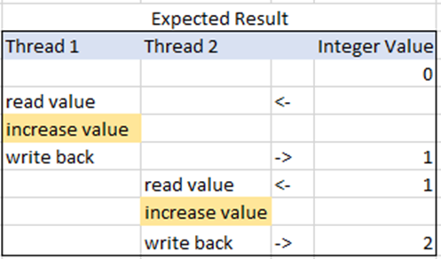
How to fix race condition errors
The best solution to fix a race condition is to put “locks” into place
This makes it so only one thread is able to use the variable at a time
For example: If thread 1 is using the variable and thread 2 needs to use it, thread 2 will halt executions until thread 1 is finished with the variable. Once its finished, it passes the variable on to thread 2 to use
This will ensure you get the correct result every time the program is run

Slide 6
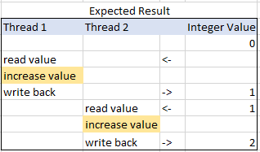
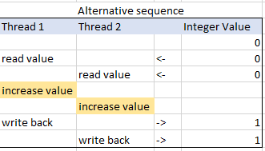
How to fix race condition errors
In the case shown on the left, the final value is 2, as expected. If the threads are run without locking, however, the outcome of the operation could be wrong (shown on right).

Slide 7

Thread 1
Add 1 then return
Thread 2
Add 1 then return
Variable
5

Slide 8

Thread 1
Add 1 then return
Thread 2
Add 1 then return
6
Variable

Slide 9

Thread 1
Add 1 then return
Thread 2
Add 1 then return
Variable
6

Slide 10

Thread 1
Add 1 then return
Thread 2
Add 1 then return
7
Variable

Slide 11

Thread 1
Add 1 then return
Thread 2
Add 1 then return
Variable
7
7

Slide 12
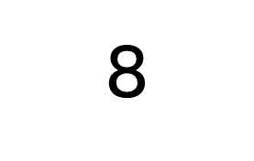

Thread 1
Add 1 then return
Thread 2
Add 1 then return
8
Variable

Slide 13
So..
Instead of Thread 1 and Thread 2 alternating through their processes, they end up trying to grab the same variable at the same time, resulting in the final answer being 8 instead of 9.
If you put locks into place, however, it works as it was expected to

Slide 14

Thread 1
Add 1 then return
Thread 2
Add 1 then return
LOCK
Variable
5

Slide 15

Thread 1
Add 1 then return
Thread 2
Add 1 then return
6
LOCK
Variable

Slide 16

Thread 1
Add 1 then return
Thread 2
Add 1 then return
LOCK
Variable
6

Slide 17


Thread 1
Add 1 then return
Thread 2
Add 1 then return
7
Variable

Slide 18

Thread 1
Add 1 then return
Thread 2
Add 1 then return
Variable
7

Slide 19


Thread 1
Add 1 then return
Thread 2
Add 1 then return
Variable

Slide 20

Thread 1
Add 1 then return
Thread 2
Add 1 then return
LOCK
Variable
8

Slide 21

Thread 1
Add 1 then return
Thread 2
Add 1 then return
9
Variable

