Slide 1
Race Conditions

Slide 2
What is a race condition?
A race condition occurs when two threads access a shared variable at the same time
The first and second thread both perform their operations on the value read in from the variable, and they race to see which thread can write the value last to the shared variable
The value that is written last is preserved because the values written previously are overwritten
If a program has a race-condition vulnerability, attackers can run a parallel process to race against the program to change the behaviors of the program

Slide 3
Causes of race conditions
The most common cause of a race-condition is unpredictable values of shared variables between multiple threads
This results in unpredictability of the order of which the threads execute
Sometimes it works; Sometimes it doesn’t
If each thread is executed separately, the variable value will behave as expected

Slide 4
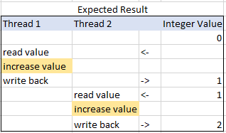
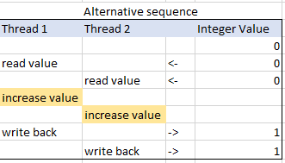
Example:
In the case shown on the left, the final value is 2, as expected. If the threads are run without locking, however, the outcome of the operation could be wrong (shown on right).

Slide 5
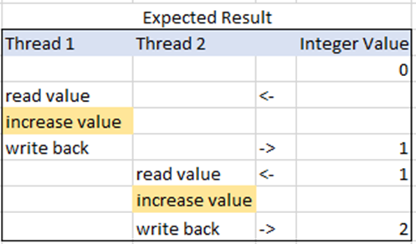


How to fix race condition errors
The best solution to fix a race condition is to put “locks” into place
This makes it so only one thread is able to use the variable at a time
For example: If thread 1 is using the variable and thread 2 needs to use it, thread 2 will halt executions until thread 1 is finished with the variable. Once its finished, it passes the variable on to thread 2 to use
This will ensure you get the correct result every time the program is run

Slide 6
Thread 1
Add 1 then return
Thread 2
Add 1 then return
Variable
5

Slide 7
Thread 1
Add 1 then return
Thread 2
Add 1 then return
6
Variable

Slide 8
Thread 1
Add 1 then return
Thread 2
Add 1 then return
Variable
6

Slide 9
Thread 1
Add 1 then return
Thread 2
Add 1 then return
7
Variable

Slide 10
Thread 1
Add 1 then return
Thread 2
Add 1 then return
Variable
7
7

Slide 11
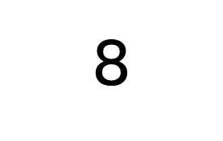
Thread 1
Add 1 then return
Thread 2
Add 1 then return
8
Variable

Slide 12
So…
Instead of Thread 1 and Thread 2 alternating through their processes, they end up trying to grab the same variable at the same time, resulting in the final answer being 8 instead of 9.
If you put locks into place, however, it works as it was expected to:

Slide 13
Thread 1
Add 1 then return
Thread 2
Add 1 then return
LOCK
Variable
5

Slide 14
Thread 1
Add 1 then return
Thread 2
Add 1 then return
6
LOCK
Variable

Slide 15
Thread 1
Add 1 then return
Thread 2
Add 1 then return
LOCK
Variable
6

Slide 16

Thread 1
Add 1 then return
Thread 2
Add 1 then return
7
Variable

Slide 17
Thread 1
Add 1 then return
Thread 2
Add 1 then return
Variable
7

Slide 18

Thread 1
Add 1 then return
Thread 2
Add 1 then return
Variable

Slide 19
Thread 1
Add 1 then return
Thread 2
Add 1 then return
LOCK
Variable
8

Slide 20
Thread 1
Add 1 then return
Thread 2
Add 1 then return
9
Variable

